Slide 1



Slide 2

David Postlethwaite
Five
Ten
Top Disasters we’ve seen as DBAs
Pięć największych katastrof, z jakimi się spotkaliśmy jako administratorzy baz danych

Slide 3



David Postlethwaite
SQL and Oracle DBA, Azure Powe BI Admin.
MCSE 2014 Data Platform
Oracle OCA
25+ years IT Experience
15+ years as DBA
E-MAIL
david@clunyweb.co.uk
LINKEDIN
www.linkedin.com/in/davidpostlethwaite
TWITTER
@postledm
bankingcircle.com/careers
Notes:
Welcome
Good morning.
My name is David Postlethwaite, I work for Banking Circle, a financial services company based in Copenhagen and in Luxemburg
I have been working as both a SQL Server and Oracle DBA for well over 15 years
Now as well as DBA work I am also Azure Administrator , Power BI admin, automation, PowerShell and anything else my company needs to me to do

Slide 4


Gethyn Ellis
Microsoft, Azure, Power Platform Trainer
E-MAIL
gethyn@gethynellis.com
LINKEDIN
linkedin.com/in/gethynellis/
TWITTER
@gethyn_ellis
Notes:
Let me give you a little bit of information about me.
I have been working with SQL Sever and the Microsoft data platform for about 20 years.
In that time I have had a variety of jobs, from report writer, web developer and DBA
For the last 12 years I have been running a small consulting and training business, gethynellis.com, and of late we have partnered with our good friends at Wyeden to offer cost effective end to solutions in the following areas
Data platform architecture and design - including high availability and disaster recovery solutions and obviously how to licence those
SQL Server migrations – including upgrades and migrations to a range of cloud solutions
SQL Server health Checks and performance tune ups.
SQL Server and Microsoft Data platform training including the Microsoft Official Curriculum of courses
You can follow me on twitter and feel free to look me up and connect with me on LinkedIn – we follow back
If you have any questions on what we discuss in this session today, do feel free to send me an email
Let me tell you a story, it involves:
Berry Wand
Billy Beane
Peter Brand
And this my friends is a true story

Slide 5






Notes:
So here goes
Let me share with you the top 10 things that I’ve seen go bad in my time as a DBA
And the lesson learnt as a result

Slide 6


Slide 7

1. Lost SA password
What do you do when no one is a sysadmin?
Start SQL in single user mode.
-f
This isn’t useful because your one connection might be grabbed by a system process
You can specify the program that can be used to connect with –m <program>
-mSQLCMD
Then login using sqlcmd
SQLCMD -S"ServerName“
Notes:
Lost SA password

Slide 8
1a. Lost SA password
Run SQL command to add the sysadmins
Run SQL command to add the sysadmins (cmd window must be in admin mode)
Restart SQL without the –m flag You can now login again with your domain login
You can use SSMS but this can only be set from the command line not from Configuration Manager
-m"Microsoft SQL Server Management Studio - Query"
USE [master]
GO
CREATE LOGIN [Domain\SQL Admins] FROM WINDOWS WITH DEFAULT_DATABASE=[master]
GO
ALTER SERVER ROLE [sysadmin] ADD MEMBER [Domain\SQL Admins]
GO
Notes:
If you really want to use SSMS then you can’t use The configuration manager, it doesn’t like quotes
You must restart using something like this
net start "SQL Server (MSSQLSERVER)" /m"Microsoft SQL Server Management Studio - Query"

Slide 9
2. Corrupt Log File
How do you attach a database when you only have the data file
Closed Transactions
Open Transactions
CREATE DATABASE [MissingDB1] ON ( FILENAME = N'C:\DATA\DB1.mdf’ )
FOR ATTACH
Undocumented feature
CREATE DATABASE [MissingDB2] ON ( FILENAME = N'C:\DATA\DB1.mdf’ )
FOR ATTACH_FORCE_REBUILD_LOG;
Notes:
This happened to us many years ago when the NAS that contained the database files crashed and took down all of our SQL servers
When we got the servers backup , one database was faulty, the transaction log file was corrupt
Worse the database had open transactions when it crashed so it was not possible to rebuild the database and create a new log file.
We didn’t have a backup close enough to the crash time that suited the business (never believe the business when they say a daily backup is enough)
We weren’t aware of the ATTACH_FORCE_REBUILD_LOG option but we found another elegant solution

Slide 10
2a. Corrupt Log File
Or create a new DB, take it offline, point it to the old data file
CREATE DATABASE [MissingDB1] ON ( FILENAME = N'C:\DATA\DB1.mdf’ )
FOR ATTACH--Create a new database
CREATE DATABASE [DB1]
ON (NAME = N'DB1_DB', FILENAME = N'C:\DATA\DB3.mdf' )
LOG ON ( NAME = N'DB1_Log', FILENAME = N'C:\DATA\DB1_log.ldf')
--Take the new database offline
ALTER DATABASE MissingDB1 SET OFFLINE
--Change the location of the DB files ´to the corrupt data files
ALTER DATABASE [DB1] MODIFY FILE(NAME='DB1_DB', FILENAME= 'C:\DATA\DB1.mdf')
ALTER DATABASE DB1 SET EMERGENCY;
ALTER DATABASE DB1 SET SINGLE_USER;
DBCC CHECKDB('DB1', REPAIR_ALLOW_DATA_LOSS) WITH ALL_ERRORMSGS;
ALTER DATABASE DB1 SET MULTI_USER;
--now go and find out what data you've lost
Notes:
This is the script we used to recover the database and create a new log file
Create a new database with the same name as the corrupt database but with a new datafile
Take if offline
Alter the database to use the original data file
Then repair it

Slide 11
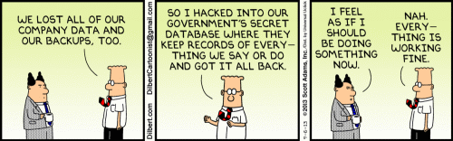
3. Backup Checks
Agent job with invalid owner
Backup Checks
DBAChecks
dbatools.io
Restore Checks
https://dbatools.io
https://stuart-moore.com/day-10-simple-restores-31-days-of-dbatools-backup-and-restores/
https://ola.hallengren.com/
https://www.gethynellis.com/2022/03/sqlbits-2022-top-five-disasters-weve-dealt-with-in-our-time-as-dbas-sql-server-backup-checks.html
Notes:
Of course we do take backups seriously . But here is something that once went wrong with our backups
This was more a of a potential disaster rather than an actual one.
Like most of you, we use the SQL agent job to run our backups
In this case the person who created the Agent job, left himself as the owner of the job. He left the company and eventually his AD account was deleted.
If that happens the Agent job will fail to run.
We didn’t get the failure notifications because of a problem with emails so we didn’t realise for several weeks that we weren’t doing any backups. Fortunately we didn’t need to restore the database so we got away with it
* As a result I decided we needed some extra checks.
Now I use a spare sql server (my audit server) to query each SQL instance for its backup data in the msdb database. I then check that each database has had a backup within the accepted time frame, the last 24 hours
It would then email the results first thing in the morning to the DBAs.
That was written 10+ years ago using bespoke code but
* If I started today I would probably use dbachecks which is a part of the dbatools PowerShell world.
* Of course, a backup is only any good if you can restore it.
Dbatools to the rescue again.
With the help of an article by Stuart Moore I wrote PowerShell script that will restore the latest backup of each database on each instance.
It works out the full, differential and log backup files it needs for the restore test. And it then emails me the results.
We run this on a quiet time on Sunday to prove that the latest backup files are valid .
So I am now confident that I have a backup and that it can be restored.
All this information - showing backups were taken and restores completed help to keep the auditors happy.
Though the auditors are now asking for proof of the existence of the backup files (another Posh script) and even asking for proof that we can restore an Azure SQL database.
* We don’t want to bore you with endless lines of PowerShell code but if you are interested we have a blog on GethynEllis.com with the details.

Slide 12
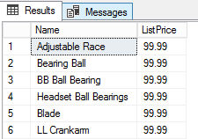
4. UPDATE without WHERE clause
UPDATE [AdventureWorks2017].[Production].[Product]
SET [ListPrice] = 99.99
Four Eyes Check on the code
Ensure you have a Change Control process
Check number of expected rows beforehand
Use transactions so you can rollback
Ensure Security and roles are in place
Only allow operations to run data fixes on production systems
Notes:
Oh dear
I’m sure we have all come across this little gem. David had one the other week, fortunately on a UAT database. And a not so important table
The moral of this is what checks do you have in place
Four Eyes Check on the code
Ensure you have a Change Control process
Check number of expected rows beforehand
Use transactions so you can rollback
Ensure Security and roles are in place
Only allow operations to run data fixes on production systems (separation of duties)

Slide 13

5. Data Centre Flooding
Ensure you have a disaster recovery plan And test it at least once a year!
Notes:
This is one of Gethyn’s
The main data centre was in the basement of the building
Up the corridor there was a drain!
The drain blocked and caused the basement to flood
People wading in the computer room in Wellies
Managed to fail over to other DC all good but bad planning on the original DC
It took the power out before flooding the room, it was on a raised floor so that protected it, other DC was the other side of site (since been moved to a completely different location). No data loss, successful failover

Slide 14
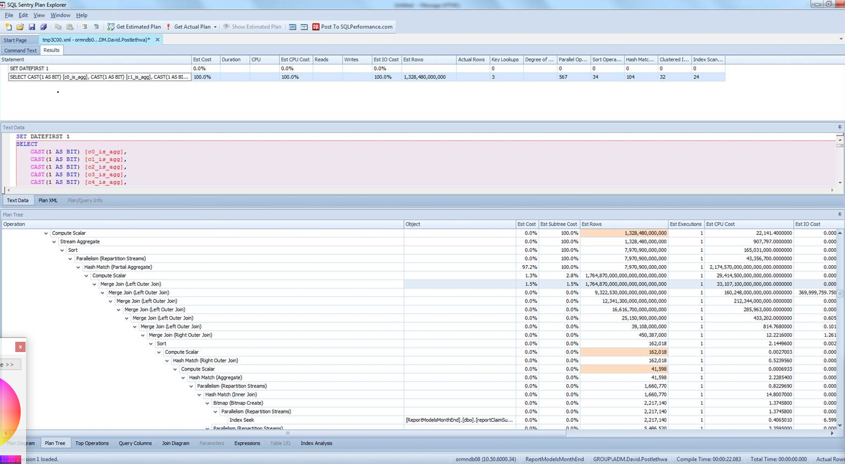

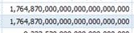
6 Missing Join Predicate
Notes:
This is my favourite
This happened to me many years ago and I recently found this screen shot in my archive
A developer came to me and said his query was taking way too long to run and could he have more memory or CPU to make it work, -
You know, the normal request when it’s slow. Let’s not look at the underlying reason let’s just throw more horsepower at it.
If you look at the number of rows its going to return, you can see it’s quite big.
Unfortunately I didn’t record the actual query but if I remember rightly it looked something like this
Can anyone spot the error (next slide)

Slide 15
6. Missing Join Predicate
SELECT [C].[CustomerName]
,[C].[PrimaryContactPerson]
,[O].[LastEditedBy]
,[O].[OrderID]
,[OL].[Description] AS [Description]
,[OLT].[Description] AS [Full Desc]
,[I].[CustomerPurchaseOrderNumber] AS [Order No]
FROM [Sales].[Customers] C
RIGHT OUTER JOIN [Sales].[Orders] O ON [C].[CustomerID] = [O].[CustomerID]
RIGHT OUTER JOIN [Sales].[OrderLines] OL ON [O].[OrderID] = [OL].[OrderID]
RIGHT OUTER JOIN [Sales].[OrderLinesTemp] OLT ON [O].[OrderID] = [OL].[OrderID]
INNER JOIN [Sales].[Invoices] I ON [I].[OrderID] = [OL].[OrderID]
SELECT COUNT(*) FROM [Sales].[Customers] --663
SELECT COUNT(*) FROM [Sales].[Orders] --73.595
SELECT COUNT(*) FROM [Sales].[OrderLines] --231.412
SELECT COUNT(*) FROM [Sales].[OrderLinesTemp] --925.648
SELECT COUNT(*) FROM [Sales].[Invoices] --70.510
-- 245.072.000.000 (245 billion) rows (10.487.100)
Notes:
Can anyone spot the mistake in the query ?
This is similar but gives the same problem as the original query
The original query had a lot of joins but in copying and pasting the JOIN text the developer had forgotten to change the column name and produced a Cartesian join
RIGHT OUTER JOIN [Sales].[OrderLinesTemp] OLT ON [O].[OrderID] = [OL].[OrderID]
With corrected query it would return 10,487,100

Slide 16
1,764,870,000,000,000,000,000,000
Amount | American | European
1,000,000,000,000,000,000,000,000 | 1 septillion | 1 quadrillion
1,000,000,000,000,000,000,000 | 1 sextillion | 1,000 trillion
1,000,000,000,000,000,000 | 1 quintillion | 1 trillion
1,000,000,000,000,000 | 1 quadrillion | 1,000 billion
1,000,000,000,000 | 1 trillion | 1 billion
1,000,000,000 | 1 billion | 1,000 million; 1 milliard
1,000,000 | 1 million | 1 million
1000 | 1 thousand | 1 thousand
100 | 1 hundred | 1 hundred
Notes:
Number naming depends if your are European or American
But whichever way you look at it, that query is asking SQL to return more rows than there are stars in the universe
Can’t understand why it failed
The moral of the story is, if its not working as expected check your query , check the execution plan

Slide 17
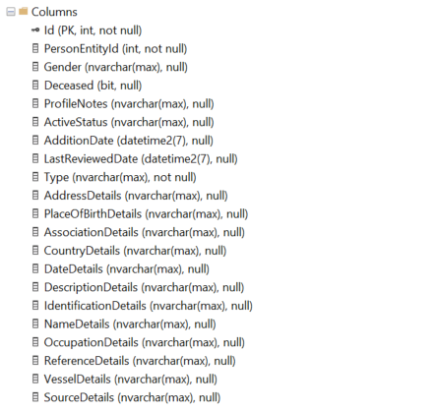
7. Entity Framework
Varchar(max) and Nvarchar(max)
Notes:
Entity Framework may be a great tool but if you don’t understand what it is doing you can end up with some very badly designed tables
The most common thing I see is varchar(max) for nearly every text column
A developer told me recently that it didn’t matter if everything was varchar(max) because SQL only uses the space it needs.
This is true but when the query engine is estimating the amount of memory it requires, it will assume that you really do mean to use that 2GB that you can have in the max column.
And allocate memory accordingly

Slide 18
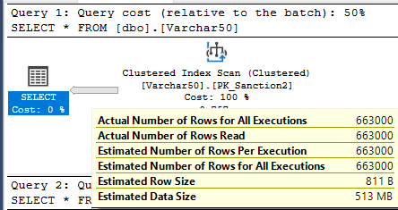
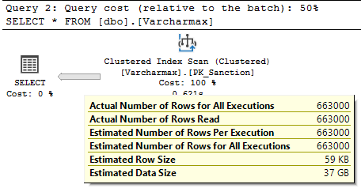
7a. Entity Framework
Varchar(max) and Nvarchar(max)
Varchar(max) can’t be indexed
Istrue varchar(1)
Year varchar(4)
Notes:
--varcharmax example
-- Two tables one all varchar(max) and one with varchar(50)
-- fill both with exactly the same data, all less than 50 chars long
USE WideWorldImporters
GO
--Create Varcharmax table
CREATE TABLE [dbo].[Varcharmax](
[Id] [int] IDENTITY(1,1) NOT NULL,
[ProfileNotes] [nvarchar](max) NULL,
[ActiveStatus] [nvarchar](max) NULL,
[AdditionDate] [datetime2](7) NULL,
[LastReviewedDate] [datetime2](7) NULL,
[Type] [nvarchar](max) NOT NULL,
[AddressDetails] [nvarchar](max) NULL,
[PlaceOfBirth] [nvarchar](max) NULL,
[Association] [nvarchar](max) NULL,
[Country] [nvarchar](max) NULL,
[DateDetails] [nvarchar](max) NULL,
[Description] [nvarchar](max) NULL,
[Identification] [nvarchar](max) NULL,
[FullName] [nvarchar](max) NULL,
[Occupation] [nvarchar](max) NULL,
[Reference] [nvarchar](max) NULL,
[Vessel] [nvarchar](max) NULL,
[Source] [nvarchar](max) NULL,
CONSTRAINT [PK_Sanction] PRIMARY KEY CLUSTERED
(
[Id] ASC
)WITH (PAD_INDEX = OFF, STATISTICS_NORECOMPUTE = OFF, IGNORE_DUP_KEY = OFF, ALLOW_ROW_LOCKS = ON, ALLOW_PAGE_LOCKS = ON, OPTIMIZE_FOR_SEQUENTIAL_KEY = OFF) ON [PRIMARY]
) ON [PRIMARY] TEXTIMAGE_ON [PRIMARY]
GO
--Create Varchar50 table
CREATE TABLE [dbo].[Varchar50](
[Id] [int] IDENTITY(1,1) NOT NULL,
[ProfileNotes] [nvarchar](50) NULL,
[ActiveStatus] [nvarchar](50) NULL,
[AdditionDate] [datetime2](7) NULL,
[LastReviewedDate] [datetime2](7) NULL,
[Type] [nvarchar](50) NOT NULL,
[AddressDetails] [nvarchar](50) NULL,
[PlaceOfBirth] [nvarchar](50) NULL,
[Association] [nvarchar](50) NULL,
[Country] [nvarchar](50) NULL,
[DateDetails] [nvarchar](50) NULL,
[Description] [nvarchar](50) NULL,
[Identification] [nvarchar](50) NULL,
[FullName] [nvarchar](50) NULL,
[Occupation] [nvarchar](50) NULL,
[Reference] [nvarchar](50) NULL,
[Vessel] [nvarchar](50) NULL,
[Source] [nvarchar](50) NULL,
CONSTRAINT [PK_Sanction2] PRIMARY KEY CLUSTERED
(
[Id] ASC
)WITH (STATISTICS_NORECOMPUTE = OFF, IGNORE_DUP_KEY = OFF, OPTIMIZE_FOR_SEQUENTIAL_KEY = OFF) ON [PRIMARY]
) ON [PRIMARY]
GO
-- Insert same data to both tables
TRUNCATE TABLE [dbo].[Varcharmax]
GO
INSERT INTO [dbo].[Varcharmax](
[FullName],
[ProfileNotes],
[ActiveStatus],
[AdditionDate],
[LastReviewedDate],
[Type],
[AddressDetails],
[PlaceOfBirth],
[Association],
[Country],
[DateDetails],
[Description],
[Identification],
[Occupation],
[Reference],
[Vessel],
[Source])
SELECT
[CustomerName]
,[DeliveryAddressLine1]
,[DeliveryAddressLine2]
,GETDATE()
,GETDATE()
,[DeliveryAddressLine1]
,[PostalAddressLine1]
,[PostalAddressLine2]
,[PostalPostalCode]
,[DeliveryAddressLine1]
,[DeliveryAddressLine2]
,[DeliveryPostalCode]
,[DeliveryAddressLine1]
,[DeliveryAddressLine2]
,[DeliveryPostalCode]
,[DeliveryAddressLine2]
,[DeliveryPostalCode]
FROM [WideWorldImporters].[Sales].[Customers]
GO 1000
TRUNCATE TABLE [dbo].[Varchar50]
GO
INSERT INTO [dbo].[Varchar50](
[FullName],
[ProfileNotes],
[ActiveStatus],
[AdditionDate],
[LastReviewedDate],
[Type],
[AddressDetails],
[PlaceOfBirth],
[Association],
[Country],
[DateDetails],
[Description],
[Identification],
[Occupation],
[Reference],
[Vessel],
[Source])
SELECT
[CustomerName]
,[DeliveryAddressLine1]
,[DeliveryAddressLine2]
,GETDATE()
,GETDATE()
,[DeliveryAddressLine1]
,[PostalAddressLine1]
,[PostalAddressLine2]
,[PostalPostalCode]
,[DeliveryAddressLine1]
,[DeliveryAddressLine2]
,[DeliveryPostalCode]
,[DeliveryAddressLine1]
,[DeliveryAddressLine2]
,[DeliveryPostalCode]
,[DeliveryAddressLine2]
,[DeliveryPostalCode]
FROM [WideWorldImporters].[Sales].[Customers]
GO 1000
--prove data looks the same
SELECT COUNT(*) FROM [dbo].[Varcharmax]
SELECT COUNT(*) FROM [dbo].[Varchar50]
GO
SELECT TOP (500) * FROM [dbo].[Varcharmax]
SELECT TOP (500) * FROM [dbo].[Varchar50]
--Now run same full query on both tables (663,000 rows)
-- Query Options: turn off display data
--TURN ON EXECUTION PLAN

Slide 19


8. Heaps and Tables (Entity Framework again)
Non clustered Primary Keys. No Clustered Index
Disadvantages of Heaps (https://www.dbi-services.com/blog/heap-deallocation-indexoptimize)
SQL Server does not deallocate pages when doing a DELETE on a Heap.
A Heap does not scale well because of PFS contention
You cannot efficiently search for data in a Heap.
The time to search for data in a Heap increases linearly with the volume of data.
Frequent data updates risk forwarded records
When the Heap is rebuilt it requires an update of all the non-clustered indexes.
Notes:
Heaps and Tables
Entity Framework seems to love to create non clustered Primary keys. And no clustered index at all.
Still not sure if this is by design or just developers not understanding what they are doing.
Not having a clustered index in most cases is bad news
Disadvantages of Heaps
SQL Server does not deallocate pages when doing a DELETE on a Heap. When a row is deleted, it does not mark the space as reusable, as a result, the space remains allocated and consumes more disk space. A Heap cannot scale if the database design is unsuitable because of PFS contention
You cannot efficiently search for data in a Heap.
The time to search for data in a Heap increases linearly with the volume of data.
A Heap is unsuitable for frequent data updates because of the risk of forwarded records
A Heap is horrible for every database administrator when it comes to maintenance because a Heap requires an update of non-clustered indexes when the Heap is rebuilt.
Forwarded records are records in a SQL Server table that have grown too large for the page that it currently resides on. These types of records can only be found in heaps because tables with a clustered index keep the data sorted based on the clustered index. With a heap, once the record outgrows the page, the record is moved to a new page and a forwarding pointer is left in the original location to point to the new location.
Advantages of Heaps
Using a heap can be more efficient than a table with a clustered index. In general, there are some use cases for Heaps like loading staging tables or storing protocol data into a Heap, since there is no need to pay attention to sorting when saving data. Data records are saved on the next possible data page on which there is sufficient space. Furthermore, the INSERT process does not require moving down the B-Tree of an index structure to the data page to save the record!

Slide 20
8a. Heaps
Heap Delete Test
--https://www.dbi-services.com/blog/heap-deallocation-indexoptimize/
USE WideWorldImporters
GO
DROP TABLE IF EXISTS [dbo].[HeapTest]
CREATE TABLE [dbo].[HeapTest] (
[ID] INT IDENTITY
, [Char1] VARCHAR(4000) DEFAULT ''
, [Char2] VARCHAR(4000) DEFAULT ''
);
GO
ALTER TABLE [dbo].[HeapTest]
ADD CONSTRAINT PK_ID PRIMARY KEY NONCLUSTERED (ID);
--How much space are we using
SELECT [page_count], [record_count], [avg_page_space_used_in_percent]
FROM sys.dm_db_index_physical_stats (DB_ID (N'WideWorldImporters'), OBJECT_ID (N'HeapTest'), 0, DEFAULT, 'DETAILED');
GO
-- Insert 3000 rows, which will allocate 1500 pages
INSERT INTO HeapTest (Char1,Char2) VALUES (REPLICATE('a', 4000),REPLICATE('B', 4000));
GO 3000
SELECT * FROM [dbo].[HeapTest]
-- there are 3000 rows with 3000 pages.
SELECT [page_count], [record_count], [avg_page_space_used_in_percent]
FROM sys.dm_db_index_physical_stats (DB_ID (N'WideWorldImporters'), OBJECT_ID (N'HeapTest'), 0, DEFAULT, 'DETAILED');
GO
-- Delete all the rows
DELETE FROM HeapTest;
GO
-- there are now 0 rows but using 2913 pages.
SELECT [page_count], [record_count], [avg_page_space_used_in_percent]
FROM sys.dm_db_index_physical_stats (DB_ID (N'WideWorldImporters'), OBJECT_ID (N'HeapTest'), 0, DEFAULT, 'DETAILED');
GO
--reorganise our Primary non clustered Key
ALTER INDEX PK_ID ON [dbo].[HeapTest] REORGANIZE
-- Still using 2913 pages.
SELECT [page_count], [record_count], [avg_page_space_used_in_percent]
FROM sys.dm_db_index_physical_stats (DB_ID (N'WideWorldImporters'), OBJECT_ID (N'HeapTest'), 0, DEFAULT, 'DETAILED');
GO
ALTER TABLE [dbo].[HeapTest] REBUILD
-- now the space is free
SELECT [page_count], [record_count], [avg_page_space_used_in_percent]
FROM sys.dm_db_index_physical_stats (DB_ID (N'WideWorldImporters'), OBJECT_ID (N'HeapTest'), 0, DEFAULT, 'DETAILED');
GO
Notes:
--https://www.dbi-services.com/blog/heap-deallocation-indexoptimize/
USE WideWorldImporters
GO
DROP TABLE IF EXISTS [dbo].[HeapTest]
CREATE TABLE [dbo].[HeapTest] (
[ID] INT IDENTITY
, [Char1] VARCHAR(4000) DEFAULT ''
, [Char2] VARCHAR(4000) DEFAULT ''
);
GO
ALTER TABLE [dbo].[HeapTest]
ADD CONSTRAINT PK_ID PRIMARY KEY NONCLUSTERED (ID);
--How much space are we using
SELECT [page_count], [record_count], [avg_page_space_used_in_percent]
FROM sys.dm_db_index_physical_stats (DB_ID (N'WideWorldImporters'), OBJECT_ID (N'HeapTest'), 0, DEFAULT, 'DETAILED');
GO
-- Insert 3000 rows, which will allocate 1500 pages
INSERT INTO HeapTest (Char1,Char2) VALUES (REPLICATE('a', 4000),REPLICATE('B', 4000));
GO 3000
SELECT * FROM [dbo].[HeapTest]
-- there are 3000 rows with 3000 pages.
SELECT [page_count], [record_count], [avg_page_space_used_in_percent]
FROM sys.dm_db_index_physical_stats (DB_ID (N'WideWorldImporters'), OBJECT_ID (N'HeapTest'), 0, DEFAULT, 'DETAILED');
GO
-- Delete all the rows
DELETE FROM HeapTest;
GO
-- there are now 0 rows but using 2913 pages.
SELECT [page_count], [record_count], [avg_page_space_used_in_percent]
FROM sys.dm_db_index_physical_stats (DB_ID (N'WideWorldImporters'), OBJECT_ID (N'HeapTest'), 0, DEFAULT, 'DETAILED');
GO
--reorganise our Primary non clustered Key
ALTER INDEX PK_ID ON [dbo].[HeapTest] REORGANIZE
-- Still using 2913 pages.
SELECT [page_count], [record_count], [avg_page_space_used_in_percent]
FROM sys.dm_db_index_physical_stats (DB_ID (N'WideWorldImporters'), OBJECT_ID (N'HeapTest'), 0, DEFAULT, 'DETAILED');
GO
ALTER TABLE [dbo].[HeapTest] REBUILD
-- now the space is free
SELECT [page_count], [record_count], [avg_page_space_used_in_percent]
FROM sys.dm_db_index_physical_stats (DB_ID (N'WideWorldImporters'), OBJECT_ID (N'HeapTest'), 0, DEFAULT, 'DETAILED');
GO

Slide 21
9. Indexes (too many)
More doesn’t always mean better
The more indexes you have, the slower your inserts and deletes will go
Check for duplicate and unused indexes
There are plenty of example scripts online
But take care deleting indexes. https://www.brentozar.com/archive/2018/10/unused-indexes-are-they-really-unused-or-have-they-just-not-been-used-yet/
Notes:
We have all come across tables with no indexes leading to bad performance but the opposite is true, too many indexes can have the same effect
Another one from my days in the UK
We had a large database that ran on a standalone physical machine with its own disks.
We had to move to VM with shared storage. Performance went down loading data from disk and the (same) end user complained
We pointed out ways we could improve the database design but the answer was always “It worked OK on the old server”
Anyway eventually we employed a well known consultancy (Coeo) to examine the database and he found masses of duplicate and unused indexes
We shrank the database by a quarter and performance was instantly better
* check for duplicate indexes
* ensure server has been running long enough

Slide 22
10. Non Clustered Indexes
Spot the Design Flaw
CREATE TABLE [dbo].[Transfers]
(
[Id] [bigint] IDENTITY(1,1) NOT NULL,
[PaymentActivityId] [uniqueidentifier] NOT NULL,
[PaymentId] [uniqueidentifier] NOT NULL,
[ActivityId] [uniqueidentifier] NOT NULL,
[CepActivity] [varchar](75) NOT NULL,
[MessageOrCommandId] [uniqueidentifier] NULL,
[MessageOrCommandType] [varchar](70) NULL,
[MessageIdentification] [varchar](35) NULL,
[ActivityTimestamp] [datetime2](7) NOT NULL,
[Reason] [varchar](200) NULL,
[RetryCount] [int] NULL,
[ValueDate] [datetime2](7) NULL,
[UserId] [varchar](40) NULL,
[SwsMessageId] [bigint] NULL,
[RecallId] [uniqueidentifier] NULL,
[AdditionalInformation] [varchar](105) NULL,
[ReturnedAmount] [decimal](19, 5) NULL,
[CreatedDateTime] [datetime2](7) NOT NULL,
CONSTRAINT [PK_tracingeventpaymentactivity] PRIMARY KEY CLUSTERED
) ON [PRIMARY]
CREATE NONCLUSTERED INDEX [IDX_Test] ON [dbo].[Transfers]
(
[PaymentId] ASC,
[CepActivity] ASC,
[ActivityTimestamp] ASC
) INCLUDE(
[Id],
[PaymentActivityId],
[ActivityId],
[MessageOrCommandId],
[MessageOrCommandType],
[MessageIdentification],
[Reason],
[RetryCount],
[ValueDate],
[UserId],
[SwsMessageId],
[RecallId],
[AdditionalInformation],
[ReturnedAmount],
[CreatedDateTime])
ON [PRIMARY]
GO
Notes:
From the real world
An index with every column of the table in it.
Basically a copy of the table, doubling its size
Not good.

Slide 23
11. What about You ?
What’s your worst disaster?
Don’t be shy
We won’t tell anyone !

Slide 24
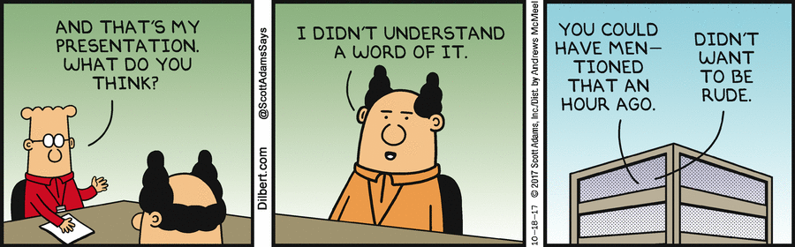
@gethyn_ellis
www.gethynellis.com
https://www.linkedin.com/in/gethynellis/
@postledm
www.linkedin.com/in/davidpostlethwaite
www.youtube.com/c/DavidPostlethwaiteSQL
Notes:
An bonus if time
Brent published this one on his blog. Quite interesting don’t have all the details.
Again check before releasing to prod

Slide 25
Lost indexes in Azure
From Brent Ozar
We are using Azure SQL DB with automatic index tuning
We just deployed a new version of our code.
Our deployment tool made the database schema match our source control
which… dropped the indexes Azure had created.
https://www.brentozar.com/archive/2023/09/oops-i-lost-my-indexes-in-azure-sql-db/
Notes:
An bonus if time
Brent published this one on his blog. Quite interesting don’t have all the details.
Again check before releasing to prod

Slide 26






PARTNERS
MEDIA PARTNERS

Slide 27



